Slide 1

ECE 281 Lesson 33
1

Slide 2
Lesson 33 Outline
Do Time Logs!
CE 5 BOC Today!
LSN 35 Lab 4 PreLab
Microarchitecture
Build I-Type Instruction
Build R-Type Instruction

Slide 3
Primary Objective for Lessons 33, 34, and Lab 4
Demonstrate the ability to design and test a microarchitecture (datapath and control unit) to implement a simple computer architecture.

Slide 4
Lesson 33/34 Objectives

Slide 5
The glue that brings
it all together!
Abstraction

Slide 6
Review
Architecture – Defined by
Instruction set
Architectural state (e.g., PC & 32 registers for MIPS)
Based on current arch. state, processor executes instruction with data set → next arch. state
What does this sound like?

Slide 7
Review
Microarchitecture…we’ll look at in two parts
Datapath – operates on words of data
includes memories, registers, ALU, muxes, etc.
How many bits for MIPS datapath?
Control – get current instruction from datapath and tells datapath how to execute

Slide 8
Computer Block Diagram
CPU
Memory
Input/
Output
Outside
World
Control
Datapath
ALU
Control Bus
Data Bus
Address Bus

Slide 9
Multiple MIPS microarchitectures
Single cycle
Multi-cycle
Pipelined

Slide 10
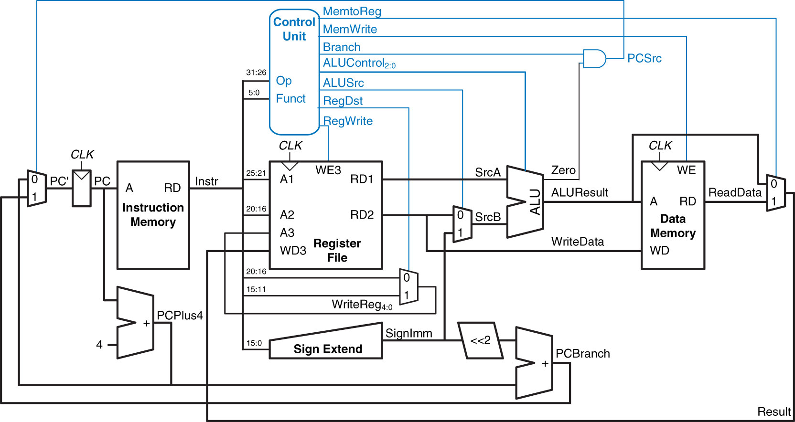
Complete Single-Cycle MIPS Processor
Control Unit - Next Lesson
Datapath
Figure 7.11 Complete single-cycle MIPS processor
Copyright © 2013 Elsevier Inc. All rights reserved.

Slide 11
Review
Microarchitecture…we’ll look at in two parts
Datapath – operates on words of data
includes memories, registers, ALU, muxes, etc.
How many bits for MIPS datapath?
Control – get current instruction from datapath and tells datapath how to execute
Instructions we’ll implement in examples
R-type arithmetic/logic: add, sub, and, or, slt
Memory: lw, sw
Branches: beq

Slide 12
Design Process - Datapath
Start with H/W for state elements (memory and arch. state)
Add blocks of combinatorial logic between state elements
New state computed on current state
Again, like creating a giant Moore FSM!
Need HW to support all 5 addressing modes:
Register Only (r-types)
Immediate (some i-types: addi, lui, etc)
Base (base addr + signed ext imm (offset), eg lw, sw, etc)
PC relative (conditionals)
Pseudo-direct (jumps)

Slide 13
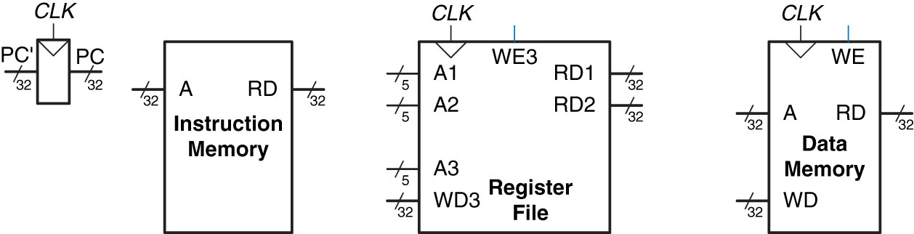
State Elements of MIPS
Processor
Instruction Memory – put in address get out data
Register File – can do two reads at once
A1 ➔ RD1 A2 ➔ RD2
A3 ➔ WD3 and is Controlled by WE
Data Memory – put in address, controlled by WE
ROM
Figure 7.1 State elements of MIPS processor
Copyright © 2013 Elsevier Inc. All rights reserved.

Slide 14
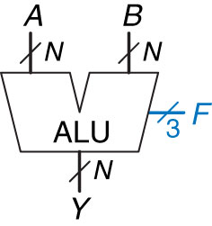
ALU
F_{2:0} | Function
000 | A & B
001 | A | B
010 | A + B
011 | not used
100 | A & ~B
101 | A | ~B
110 | A - B
111 | SLT

Slide 15
I-Type Instruction lw rt, imm(rs)
I-Type
op | rs | rt | imm
6 bits | 5 bits | 5 bits | 16 bits
31:26 | 25:21 | 20:16 | 15:0
Let’s try this:
lw rt, imm(rs)
We are going to write to rt: [rt] = [addr] = [rs +/- sigImm]

Slide 16
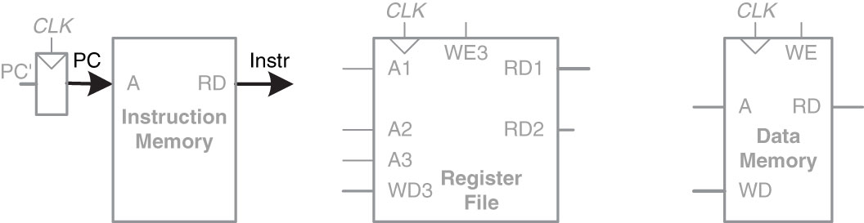
I-Type Instruction
lw rt, imm(rs)
Step 1:
I-Type
op | rs | rt | imm
6 bits | 5 bits | 5 bits | 16 bits
31:26 | 25:21 | 20:16 | 15:0
Figure 7.2 Fetch instruction from memory
Copyright © 2013 Elsevier Inc. All rights reserved.

Slide 17
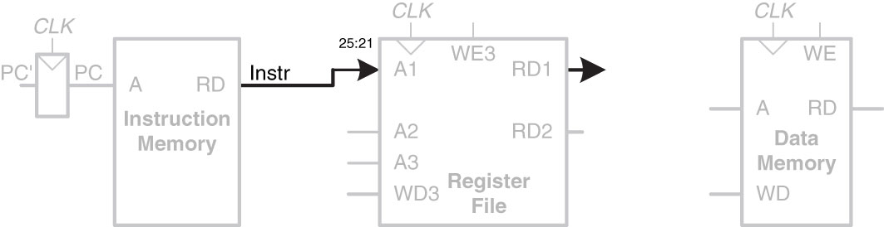
I-Type Instruction
lw rt, imm(rs)
Step 2:
Figure 7.3 Read source operand from register file
I-Type
op | rs | rt | imm
6 bits | 5 bits | 5 bits | 16 bits
31:26 | 25:21 | 20:16 | 15:0
Copyright © 2013 Elsevier Inc. All rights reserved.

Slide 18
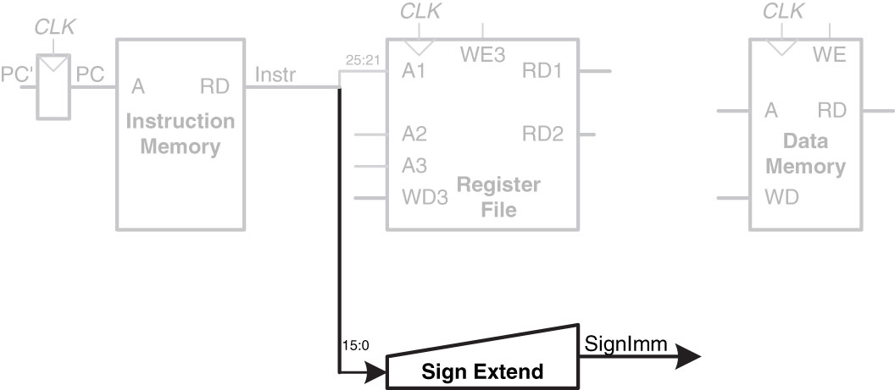
I-Type Instruction
lw rt, imm(rs)
I-Type
op | rs | rt | imm
6 bits | 5 bits | 5 bits | 16 bits
31:26 | 25:21 | 20:16 | 15:0
Step 3:
Figure 7.4 Sign-extend the immediate
Copyright © 2013 Elsevier Inc. All rights reserved.

Slide 19
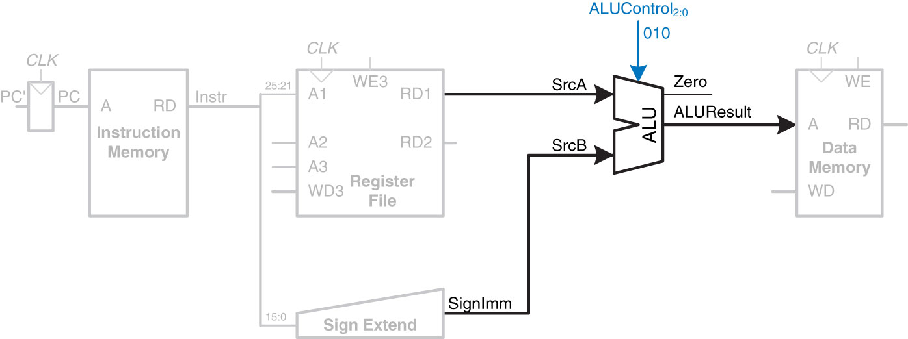
I-Type Instruction
lw rt, imm(rs)
F_{2:0} | Function
000 | A & B
001 | A | B
010 | A + B
011 | not used
100 | A & ~B
101 | A | ~B
110 | A - B
111 | SLT
Step 4:
I-Type
op | rs | rt | imm
6 bits | 5 bits | 5 bits | 16 bits
31:26 | 25:21 | 20:16 | 15:0
Figure 7.5 Compute memory address
Copyright © 2013 Elsevier Inc. All rights reserved.

Slide 20
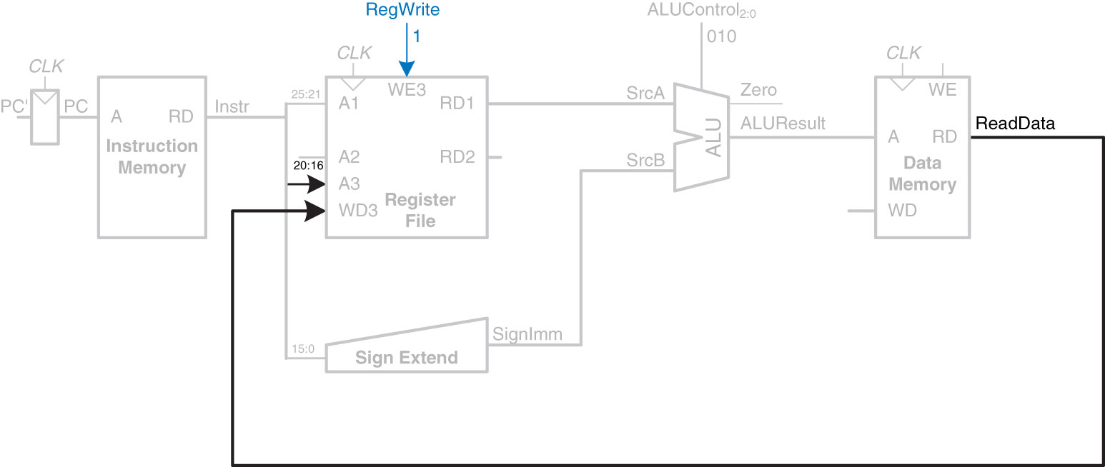
I-Type Instruction
lw rt, imm(rs)
Step 5:
I-Type
op | rs | rt | imm
6 bits | 5 bits | 5 bits | 16 bits
31:26 | 25:21 | 20:16 | 15:0
Figure 7.6 Write data back to register file
Copyright © 2013 Elsevier Inc. All rights reserved.

Slide 21
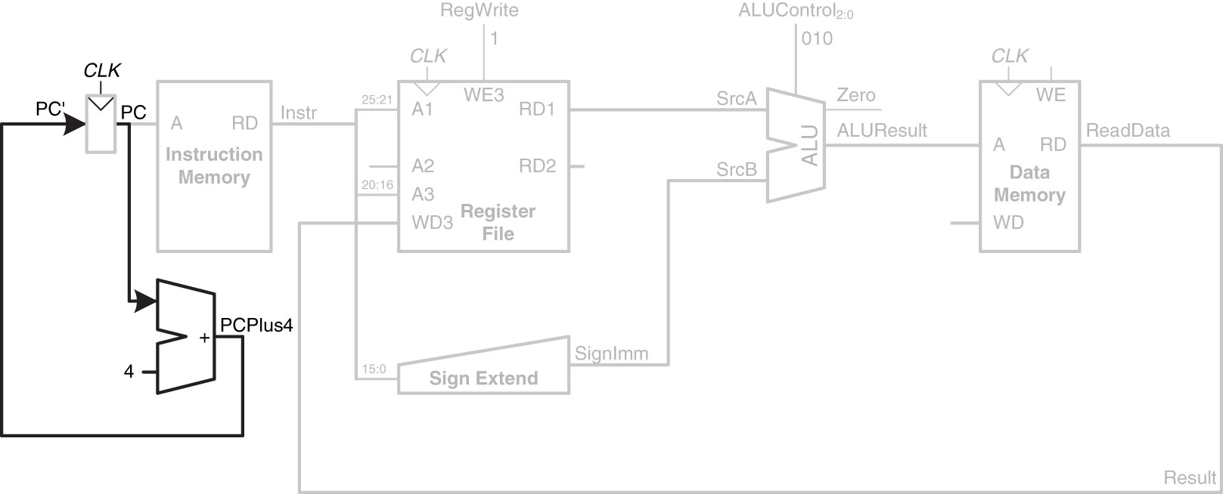
Determine address of next Instruction for PC
Step 6:
I-Type
op | rs | rt | imm
6 bits | 5 bits | 5 bits | 16 bits
31:26 | 25:21 | 20:16 | 15:0
Figure 7.7 Determine address of next instruction for PC
Copyright © 2013 Elsevier Inc. All rights reserved.

Slide 22
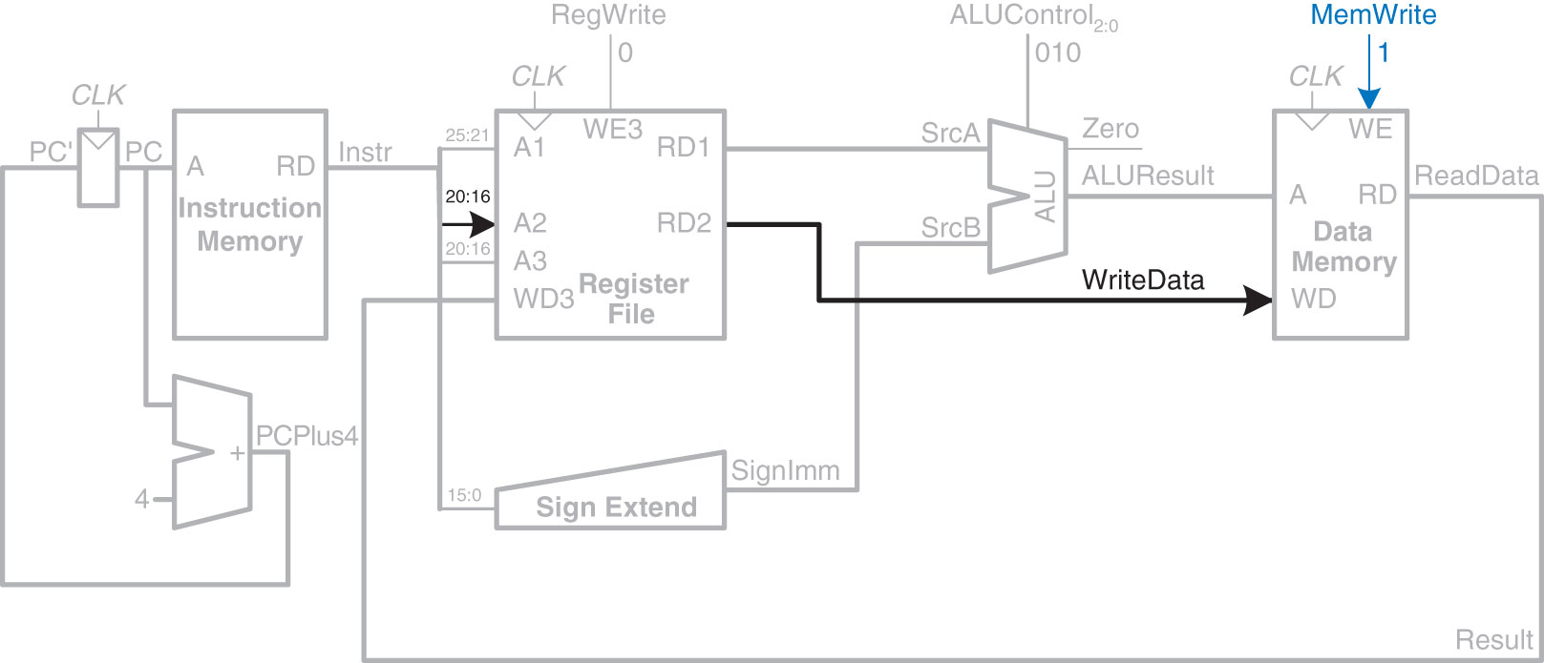
I-Type Instruction
Enhancements for SW
How about this:
sw rt, imm(rs)
Store word in memory: [rt] = [addr] = [rs +/- sigImm]
I-Type
op | rs | rt | imm
6 bits | 5 bits | 5 bits | 16 bits
31:26 | 25:21 | 20:16 | 15:0

Slide 23
R-Type Instructions
R-Type Instructions – Register Type
R-Type
op | rs | rt | rd | shamt | funct
6 bits | 5 bits | 5 bits | 5 bits | 5 bits | 6 bits
31:26 | 25:21 | 20:16 | 15:11 | 10:6 | 5:0
R-Type
op | rs | rt | rd | shamt | funct
6 bits | 5 bits | 5 bits | 5 bits | 5 bits | 6 bits
Let’s try this:
Add: [rd] = [rs] + [rt]
We are going to add 2 numbers together

Slide 24
R-Type Instructions add rd, rs, rt
R-Type
op | rs | rt | rd | shamt | funct
6 bits | 5 bits | 5 bits | 5 bits | 5 bits | 6 bits
31:26 | 25:21 | 20:16 | 15:11 | 10:6 | 5:0
R-Type
op | rs | rt | rd | shamt | funct
6 bits | 5 bits | 5 bits | 5 bits | 5 bits | 6 bits
31:26 | 25:21 | 20:16 | 15:11 | 10:6 | 5:0

Slide 25
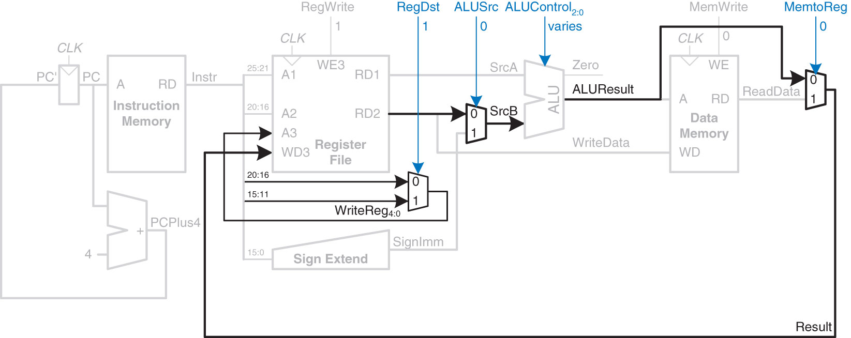
Datapath Enhancements for
R-Type Instruction
Figure 7.9 Datapath enhancements for R-type instruction
Steps for R-Type Instructions
(ex ADD: add rd, rs, rt):
Read 2 Registers
Do ALU Op
Write/Register
Add a Destination
R-Type
op | rs | rt | rd | shamt | funct
6 bits | 5 bits | 5 bits | 5 bits | 5 bits | 6 bits
31:26 | 25:21 | 20:16 | 15:11 | 10:6 | 5:0
Copyright © 2013 Elsevier Inc. All rights reserved.

Slide 26
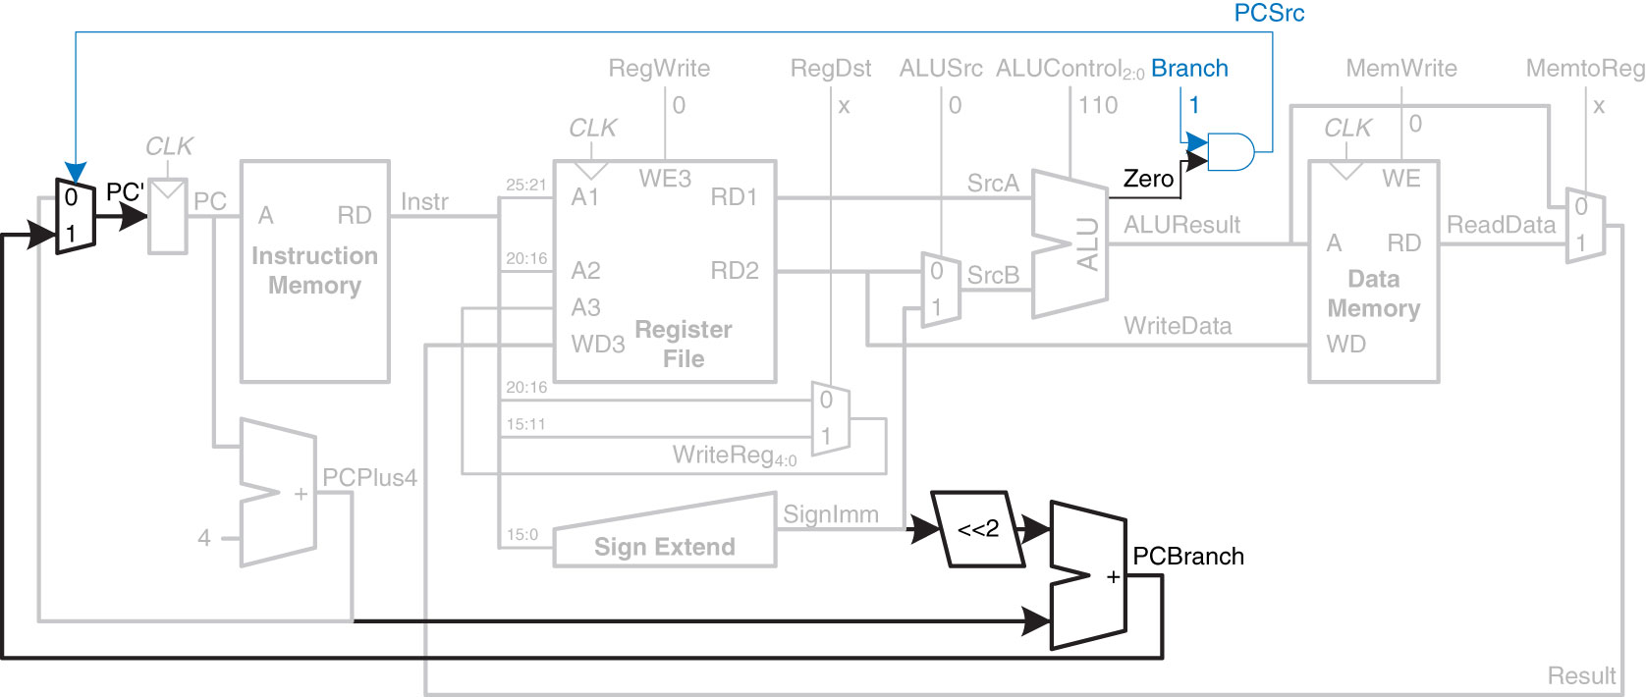
Datapath Enhancements for
BEQ Instruction
Now, let’s look at a BEQ, what do we have to change here?
beq rs, rt, label
if([rs] == [rt]) PC = BTA BTA is branch target address

Slide 27
Complete Single-Cycle MIPS Processor
Control Unit - Next Lesson
Figure 7.11 Complete single-cycle MIPS processor
Copyright © 2013 Elsevier Inc. All rights reserved.

Slide 28
Single-Cycle Processor
Three weaknesses of Single-Cycle Processor:
Needs clock cycle long enough for slowest instruction (lw)
Needs 3 adders (i.e. more $$$)
Separate instruction and data memory (not always realistic)
Recall: Multiple microarchitectures for a single architecture
MIPS:
Single-Cycle
Multi-Cycle
Pipelined

Slide 29

Single-Cycle MIPS Processor
All executed in one cycle (i.e. single-cycle MIPS)
$Execution Time=\# instructions×\frac{cycles}{instruction}×\frac{seconds}{cycle}$
➔ Assuming no memory delay

Slide 30

30

Slide 31
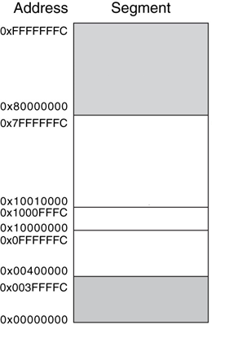
MIPS Memory Map
Reserved
Stack
$sp = 0x7FFFFFFC
Dynamic Data
Heap
Global Data
$gp = 0x10008000
Text
PC = 0x00400000
Reserved
Figure 6.31 MIPS memory map

Slide 32
Steps for Translating and starting a program
Higher Level Language (HLL)
Compiler
Assembly Language
Assembler
Object File (Machine Code)
Object Files
Library Files
Linker
Executable
Loader
Memory

Slide 33
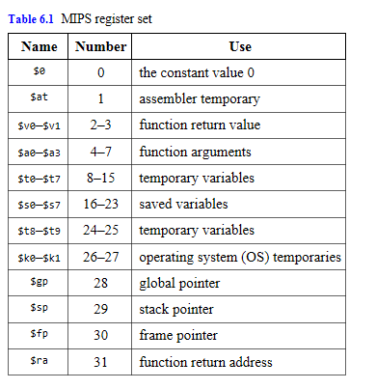
MIPS Register Set
Copyright © 2013 Elsevier Inc. All rights reserved.

Slide 34
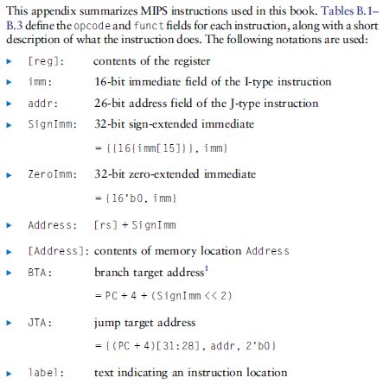
MIPS Instruction Set
Copyright © 2013 Elsevier Inc. All rights reserved.

Slide 35
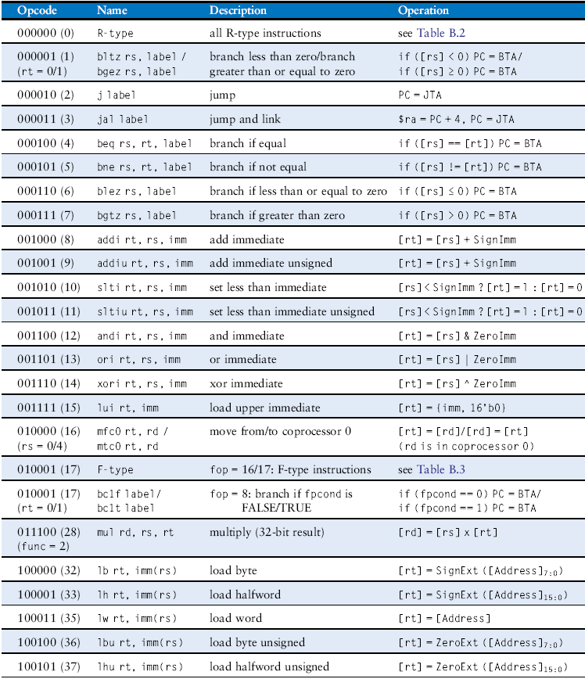
MIPS Instruction Set
Table B.1 Instructions, sorted by opcode
Copyright © 2013 Elsevier Inc. All rights reserved.

Slide 36
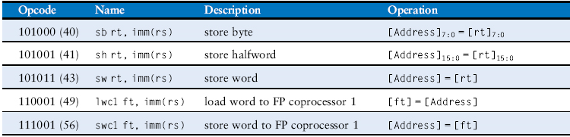
MIPS Instruction Set
Table B.1 Instructions, sorted by opcode
Copyright © 2013 Elsevier Inc. All rights reserved.

Slide 37
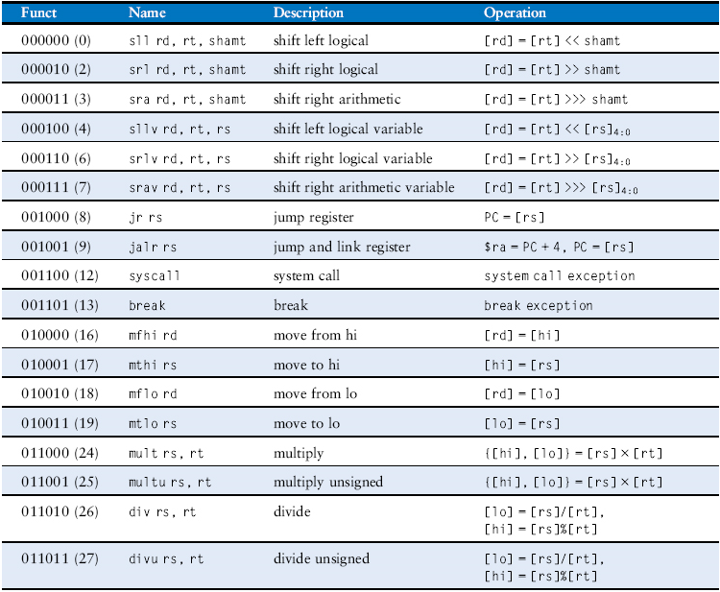
MIPS Instruction Set
Table B.2 R-type instructions, sorted by funct field
Copyright © 2013 Elsevier Inc. All rights reserved.

Slide 38
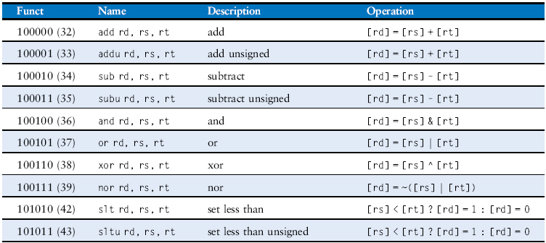
MIPS Instruction Set
Table B.2 R-type instructions, sorted by funct field
Copyright © 2013 Elsevier Inc. All rights reserved.

Slide 39
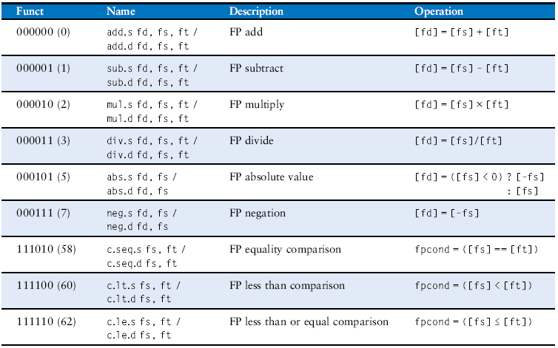
MIPS Instruction Set
Table B.3 F-type instructions (fop = 16/17)
Copyright © 2013 Elsevier Inc. All rights reserved.

Slide 40
I-Type Instructions
I-Type Instructions – Immediate Type
I-Type
op | rs | rt | imm
6 bits | 5 bits | 5 bits | 16 bits
I-Type
op | rs | rt | imm
6 bits | 5 bits | 5 bits | 16 bits
31:26 | 25:21 | 20:16 | 15:0

